Slide 1

Effective Communication: Meeting Notes
December 12, 2019
Presented by Sheila Luttrell,
as part of the OIT PMO
“Community of Practice”
brown-bag lunch series

Slide 2


Before we begin…
Interactive feedback:
Please join online at PollEv.com/sl101

Slide 3
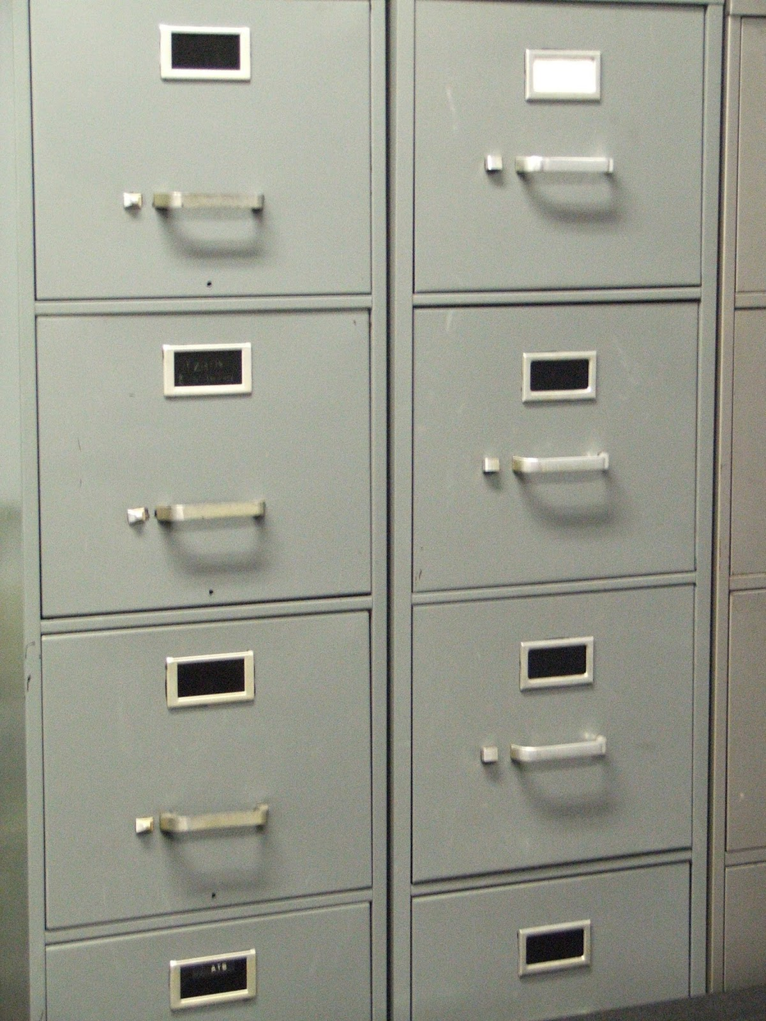
Why capture meeting notes?
Individual Project Record
Institutional Knowledge Management

Slide 4
Why are meeting notes important?
Establishes a record of what was discussed in a meeting, including any actions assigned to team members, or decisions that were made
Can be used for accountability, and to measure progress
Especially important in large teams, or environments subject to high levels of change

Slide 5
Note-Taking Tips
Summarize action items – Table in the meeting notes, or link to a master action items register in a document portal (include specific owners, and promise dates)
Summarize or highlight decisions made

Slide 6
Note-Taking Tips, Cont.
Share responsibility of note-taking… Helps with overall engagement
Rotate responsibility
Crowd-source (everyone provides input, improving accuracy)
Ask meeting attendees to review and report any inaccuracies/misrepresentations (provide a deadline)
Meeting notes should be:
respectful and appropriate for the audience
complete enough to satisfy the information needs of the recipients
self-explanatory for future users of the archived information

Slide 7

Interactive:
Visit PollEv.com/sl101
to participate, or shout out!
How do you capture and share meeting notes today?

Slide 8
How do you capture and share meeting notes today?
Capture notes in Word, Google Docs, OneNote, on paper. Distribute via email or Box
Usually key points and actions in the ppt that was presented then emailed / shared with attendees after. They get reviewed next mtg
Word doc with decisions and action items. Send for review in email with link to box
Google Docs, Word
Word document, Google Doc, email with text in-line

Slide 9
Tools For Note-Taking
Consider availability/accessibility, and technological compatibility of devices
Consider confidentiality – The need to safeguard sensitive information

Slide 10
Tools For Note-Taking
Tool | Pros | Cons
Hand-Written | Less formal, instills trust | Requires additional time to transcribe to an archive-able format
Microsoft OneNote | Easy to share (“Email Page”) All notes are centrally located (for the note-taker) | One person owns Requires additional time to transfer to an archive-able format
Email Message | Convenient | Poor retention, ease of access Less secure
Microsoft Word Document/PDF File | Relatively common platform Can be formal, detailed | Potential accessibility issues
Microsoft PowerPoint Slide Deck | Good for visual learners Accessible User-friendly | May not contain enough detail for a future consumer of the information
Google Docs/Slides | Can be collaborative Permissions can be managed | Requires Google account

Slide 11
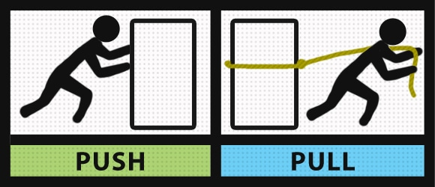
Methods of Note-Sharing
Push (email)
Pull (Box, Google Drive, other document portal)

Slide 12
Methods of Note-Sharing
Tool | Pros | Cons
Email (push) | Convenient | Not centrally available for future resources Not secure – Can be forwarded Difficult to access/find
Google Team Drive (pull) | Highly available Accessible from a variety of devices Secure Highly collaborative | Requires Google account
Box (pull) | Highly available Accessible from a variety of devices Highly secure – Granular access controls (external) | Possible version control issues Add-ins and tools may require some additional education
Blog Site/Wiki (pull) | Readily available | Not collaborative

Slide 13
Special Considerations
Consider meeting participants who have different communication needs, styles, levels of authority, cultural backgrounds, interests, and levels of expertise.
Show respect and sensitivity to these differences and improve the effectiveness of your message by customizing communications.
Appreciating other people’s perspectives creates opportunities to maintain and improve relationships, which in turn helps people be engaged and positive about your meetings.

Slide 14
Interactive:
Visit PollEv.com/sl101
to participate, or shout out!
Do you have any tips or tools to share?

Slide 15
Participant Tips
Keep a “living” document that you just update each meeting – Google Docs is a good tool for this.
Use tools that all participants are familiar/comfortable with
Ask action item assignees to go add their own promise date to the document
If you are a meeting participant taking your own notes, let the meeting facilitator know that you are engaged and taking notes – Not checking email, etc.
Meeting notes are also commonly being captured in task-tracking tools (Monday.com, Jira, etc.)
Can also use WebEx whiteboard/Teams room

Slide 16
Participant Tips, Cont.
At the start of a meeting, let participants know if you (or a delegate) will capture and share meeting notes – This allows participants to be more engaged in the meeting.
Check ISO page for recommendations on preferred tools
Zoom will transcribe meeting audio!
Always include an accurate list of actual attendees – If you are not able to attend the meeting, you can easily see a list of those who you might go to if you have questions or need more context.
People don’t often open attachments – Add the info to the body of the message if emailing
Action items should be moderated by a project manager or someone else officially assigned that responsibility, to confirm they are valid/necessary

Slide 17
Questions? Feedback?
Please complete survey at PollEv.com/sl101

Slide 18

Thank You!
Presented by Sheila Luttrell,
as part of the OIT PMO
“Community of Practice”
brown-bag lunch series

